Slide 1
Big Mart Sales Prediction
MINI PROJECT
MENTOR: Dr. Syed Abudagir Umar
Done by,
Vishweshwar Reddy. V 17211A04P4
Shashank Reddy. Y 17211A04P9
Rakha Chandre. K 17211A04K7
Vamshidhar. V 17211A04P7

Slide 2
Problem Statement / Abstract
Nowadays shopping malls and Big Marts keep the track of their sales data of each and every individual items for predicting future demand of the customer and update the inventory management as well.
These data stores basically contain a large number of customer data and individual item attributes in a data warehouse
Further anomalies and frequent patterns are detected by mining data from the data warehouse.
The resultant data can be used for predicting future sales volume with the help of different ML techniques for Big Marts.
A comparative analysis of existing model with other in terms of performance Metrix is used for analysis.

Slide 3
LITERATURE SURVEY
Sales forecasts provide insight into how a firm should manage its workforce, cash flow, and the means
This is an important precondition for the planning and decision-making of enterprises.
It allows businesses to formulate their business plans effectively.
Learning algorithms used in classification and model categories such as linear Regression, Ridge Regression, Random Forest, Decision Tree, K-Nearest Neighbors these algorithms are suitable for sales forecast.
The technique of regression is used to forecast, model the time series, and find the relationship of cause-effect between variables.

Slide 4
Expected Procedures
ARCHITECTURE
DATA EXPLORATION
DATA ANALYSIS
DATA CLEANING
FEATURE ENGINEERING

Slide 5
Data Exploration

Slide 6
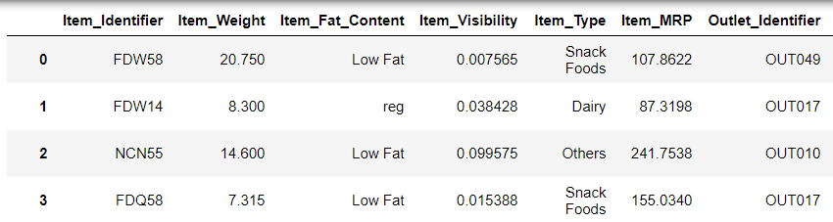
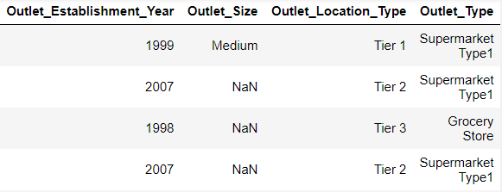
Importing Data
Code:
data_train=pd.read_csv(r'C:\Python3\projects\BigMart Sales Data\train.csv’)
Output:-

Slide 7
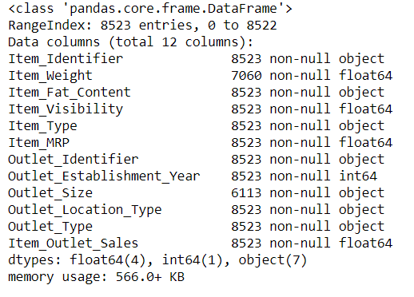
info()
Method Prints Information about Data frame including:
Index Datatype Coloumns
Non Values
Memory Usage
Commands:-
data_train.info()
Output:-

Slide 8
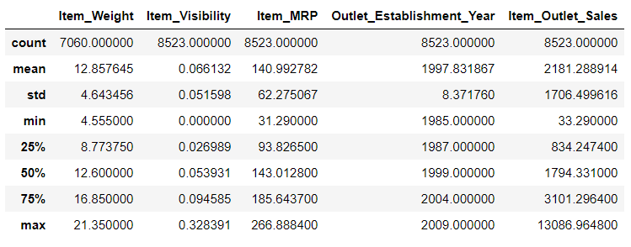
describe()
pandas.dataframe.describe()
Part of descriptive statics
Includes those that summarize the central tendency, description and shape of a datasets description, excluding NaN values
Command:-
data_train.describe()
Output:-

Slide 9
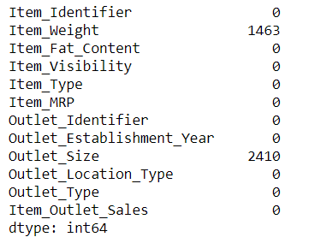
isnull().sum()
Output:-
isnull().sum() / missing values
Method prints the number of NaN values of each type column of entire data.
Command:-
data_train.isnull().sum()

Slide 10
Missing Values
Insights:-
Item_weight has 1463 missing values
Outlet_size has 2410 missing values

Slide 11
DATA ANALYSIS

Slide 12
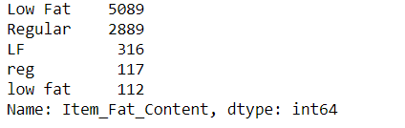
Item Fat Content
Code:
data_train.Item_Fat_Content.value_counts()
Output:-

Slide 13
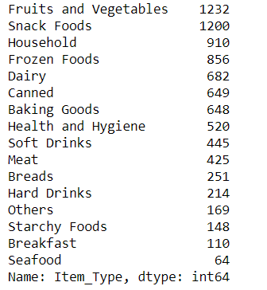
Item Type
Output:-
Code:-
data_train.Item_Type.value_counts()

Slide 14

Outlet Size
Code:-
data_train.Outlet_Size.value_counts()
Output:-

Slide 15

Outlet Location Type
Code:-
data_train.Outlet_Location_Type.value_counts()
Output:-

Slide 16
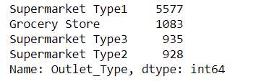
Outlet Type
Code:-
data_train.Outlet_Type.value_counts()
Output:-

Slide 17
DATA CLEANING

Slide 18
Combining Data
Combining test and train data to avoid re-work of cleaning of data
Since the data contains lot of null values, missing values and catagorial values such as duplicates
Code:
data = pd.concact([‘train’ , ’test’])
Note:
pd refers to pandas library

Slide 19
Replacing the ‘missing’ values
Filling item weight NaN values:
data['Item_Weight'].mean()
Output:- 12.695633368756374
Filling outlet size NaN values
data['Outlet_Size'].mode()[0]
Output:- Medium

Slide 20
Feature Engineering

Slide 21

Item_Type: Transform 16 types into 3
Code:-
data_train.Item_Type_Combined = data_train.Item_Identifier.apply(lambda x: x[0:2])
data_train.Item_Type_Combined = data_train.Item_Type_Combined.map({'FD':'Food’,
'NC':'Non-Consumable',
'DR':’Drinks’})
Output:-

Slide 22

Item Fat Content Transform 3 item into 2
Code:
data_train.Item_Fat_Content=data_train.Item_Fat_Content.replace({'LF':'Low Fat','low fat':'Low Fat'})
data_train.Item_Fat_Content=data_train.Item_Fat_Content.replace({'reg':'Regular’})
Output:-

Slide 23
Categorial Variable Transformation
Using One hot encoding:-
Here we categorize variables into numericals for further data analysis and improving the performance of ML algorithms.
new_trained_data=pd.get_dummies(data, columns=['Item_Fat_Content',’Ite m_Type','Outlet_Size','Outlet_Location_Type','Outlet_Type’])

Slide 24
Drop
Code:-
new_trained_data.drop(['Item_Identifier','Outlet_Identifier','Outlet_Est ablishment_Year'],axis=1,inplace=True)

Slide 25
Model Building

Slide 26
Segregation of Train and Test Data
Segregating the data into train and test for model prediction
Code:
data_train=data.iloc[:8523,:]
data_test=data.iloc[8523,:,:]
X=data_train.drop([‘Item_Outlet_Sales’],axis=1)
y=train=data_train.Item_Outlet_Sales
A=data_test

Slide 27
Linear Regression
Code:-
from sklearn.linear_model import LinearRegression
regressor = LinearRegression()
regressor.fit(X,y)
B_pred=regressor.predict(A)
B_pred
from sklearn.metrics import accuracy_score
accuracy=round(regressor.score(X,y) * 100,3)
accuracy

Slide 28
Linear Regression Model Output
Output:-
ACCURACY:-
The accuracy obtained using this model is 56.266

Slide 29
Decision Tree
Code:-
from sklearn.tree import DecisionTreeRegressor
DT=DecisionTreeRegressor(max_depth=15,min_samples_leaf=300)
DT.fit(X,y)
B_pred=regressor.predict(A)
B_pred
from sklearn.metrics import accuracy_score, r2_score, mean_squared_error
tree_accuracy=round(regressor.score(X,y)*100,3)
tree_accuracy

Slide 30
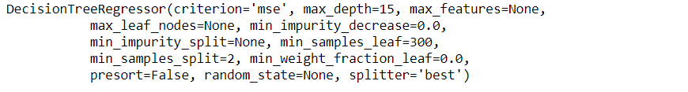
Decision Tree Algorithm Output
Output:-
Accuracy:-
The accuracy obtained using this model is 56.266

Slide 31
Random Forest
Code:
from sklearn.ensemble import RandomForestRegressor
regressor=RandomForestRegressor(n_estimators=100,max_depth=10,min_samples_leaf=50,n_jobs=4)
regressor.fit(X,y)
B_pred=regressor.predict(A)
B_pred
rf_accuracy=round(regressor.score(X,y)*100,3)
rf_accuracy

Slide 32
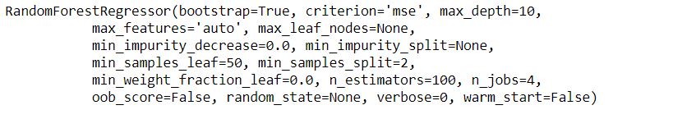
Random Forest Algorithm Output
Output:-
Accuracy:-
The accuracy obtained using this model is 62.616

Slide 33
KNN Algorithm
from sklearn.neighbors import KNeighborsRegressor
for K in range(5):
K=K+1
regressor=KNeighborsRegressor(n_neighbors=K)
regressor.fit(X,y)
B_pred=regressor.predict(A)
print(B_pred)
KNN_accuracy=round(regressor.score(X,y)*100,3)
print(KNN_accuracy)

Slide 34
KNN Algorithm Output
for
K=1
predicted sales = [2787.03, 1133.85, 5287.78,………..1068.60, 1757.71]
accuracy=100
K=2
predicted sales = [1663.16, 1098.23, 2886.24,…………2564.66, 1468.08]
accuracy=76.77
K=3
predicted sales = [1673.37, 1098.23, 2886.24, ………..3363.62, 1324.94]
accuracy=68.63
.
.
K=5
predicted sales = [1630.61, 1639.19, 3562.96, ……..2834.31, 1418.15]
accuracy=61.99

Slide 35
Accuracy Of Algorithms
Linear Regression | 56.2
Decision Tree | 56.3
Random Forest | 61.6
K-Nearest Neighbours | Let K=3 68.6

Slide 36
ADVANTAGES
Using sales forecasting and having it align with a company’s business strategy, it enables for the right resources to be allocated at the right time.
With adequate sales forecasting and having it align with your strategy will allow production to be effective and will generate the amount with the quality that is being promised within the timeframe as requested.
Adjusting your sales forecast is absolutely essential when attempting to maximize efficiency within your operation and eliminate any inventory.

Slide 37
FUTURE SCOPE
Multiple instances parameters and various factors can be used to make this sales prediction more innovative and successful.
Accuracy, which plays a key role in prediction-based systems, can be significantly increased as the number of parameters used are increased.
The project can be further collaborated in a web-based application with an in-built intelligence by virtue of Internet of Things (IoT), to be more feasible for use.
When combined with effective data mining methods and properties, the traditional means could be seen to make a higher and positive effect on the overall development of corporation’s tasks.

Slide 38
CONCLUSION
Basics of machine learning and the associated data processing and modeling algorithms have been described, followed by their application for the task of sales prediction in Big Mart shopping centers at different locations.
On implementation the prediction results show the correlation among different attributes considered and how a particular location of medium size recorded the highest sales.
Now it is evident in a way we can recommend other shopping locations should follow similar patterns for improved sales.

